Slide 1
DMS 201 : Introduction to Management Module-II: Financial Management Dr. Parvati Neelakantan

Slide 2
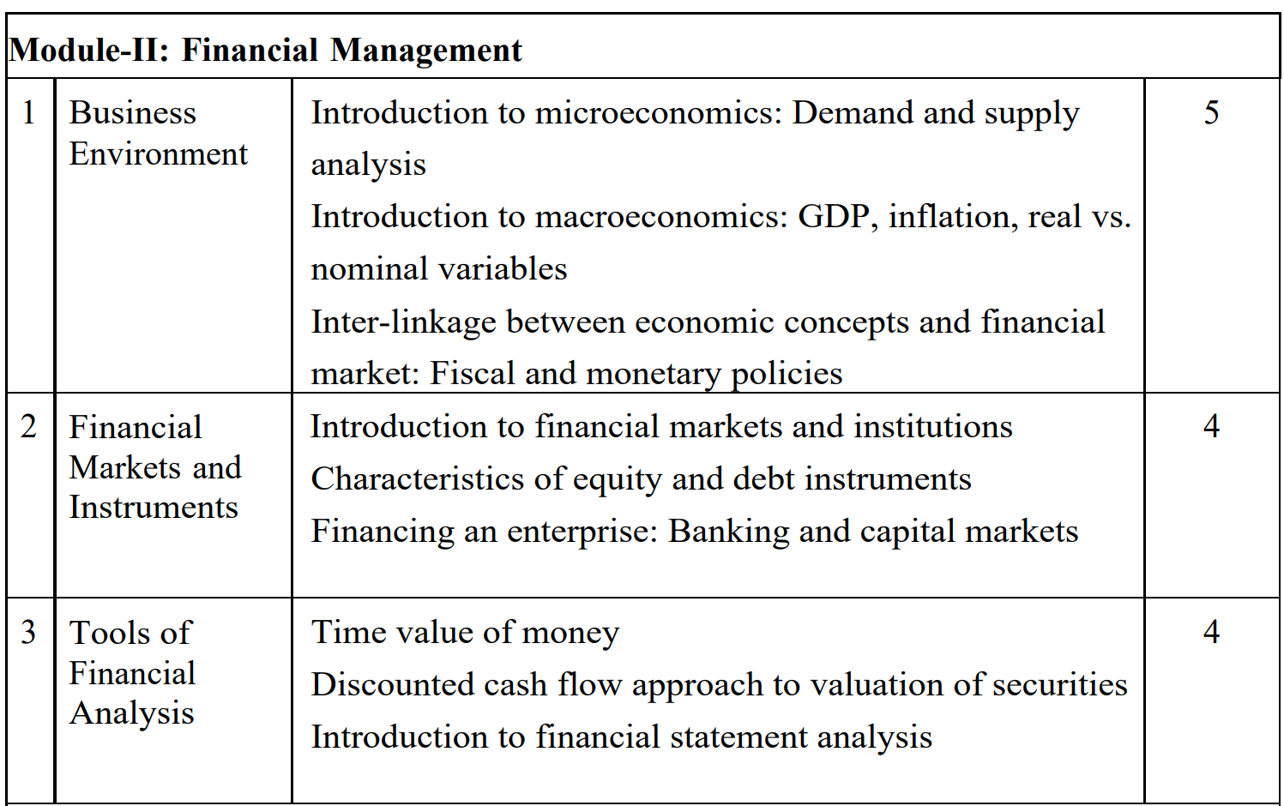
Module overview

Slide 3
Assessment
2 MCQs
1st MCQ on 26 Feb 2024 (Monday)
2nd MCQ on 11 March 2024 (Monday)
Final Exam

Slide 4
Recommended Books
Principles of Corporate Finance by Brealy, Myers, Allen.
Economics by Samuelson and Nordhaus, McGraw Hill.

Slide 5
PART 1: BUSINESS ENVIRONMENT Lecture 1: 10 Principals of economics

Slide 6
In Lecture 1 We look for the answers to these questions:
What kinds of questions does economics address?
What are the principles of how people make decisions?
What are the principles of how people interact?
What are the principles of how the economy as a whole works?

Slide 7
LEARNING OBJECTIVES
that economics is about the allocation of scarce resources.
that individuals face trade-offs.
the meaning of opportunity cost.
how to use marginal reasoning when making decisions.
how incentives affect people’s behavior.
why trade among people or nations can be good for everyone.
why markets are a good, but not perfect, way to allocate resources.
what determines some trends in the overall economy.

Slide 8
What Economics Is All About
0
Scarcity: the limited nature of society’s resources
Economics: the study of how society manages its scarce resources, e.g.
how people decide what to buy, how much to work, save, and spend
how firms decide how much to produce, how many workers to hire
how society decides how to divide its resources between national defense, consumer goods, protecting the environment, and other needs
Notes:
8

Slide 9

The principles of HOW PEOPLE MAKE DECISIONS
0
Notes:
9

Slide 10
PRINCIPLE #1: People Face Tradeoffs
0
All decisions involve tradeoffs.
Examples:
Going to a party the night before your midterm leaves less time for studying.
Having more money to buy stuff requires working longer hours, which leaves less time for leisure.
Protecting the environment requires resources that could otherwise be used to produce consumer goods.
Notes:
10

Slide 11
PRINCIPLE #1: People Face Tradeoffs
0
Society faces an important tradeoff: efficiency vs. equality
Efficiency: when society gets the most from its scarce resources
Equality: when prosperity is distributed uniformly among society’s members
Tradeoff: To achieve greater equality, could redistribute income from wealthy to poor. But this reduces incentive to work and produce, shrinks the size of the economic “pie.”
E.g.: US and EU countries
Notes:
11

Slide 12
PRINCIPLE #2: The Cost of Something Is What You Give Up to Get It
Making decisions requires comparing the costs and benefits of alternative choices.
The opportunity cost of any item is whatever must be given up to obtain it.
It is the relevant cost for decision making.
Notes:
12

Slide 13
PRINCIPLE #2: The Cost of Something Is What You Give Up to Get It
Examples: The opportunity cost of…
…going to college for a year is not just the tuition, books, and fees, but also the foregone wages.
…seeing a movie is not just the price of the ticket, but the value of the time you spend in the theater.
Notes:
13

Slide 14
PRINCIPLE #3: Rational People Think at the Margin
Rational people
systematically and purposefully do the best they can to achieve their objectives.
make decisions by evaluating costs and benefits of marginal changes, incremental adjustments to an existing plan.
Notes:
14

Slide 15
PRINCIPLE #3: Rational People Think at the Margin
Examples:
When a student considers whether to go to college for an additional year, he compares the fees & foregone wages to the extra income he could earn with the extra year of education.
When a manager considers whether to increase output, she compares the cost of the needed labor and materials to the extra revenue.
The diamond-water paradox: water is essential for life but virtually free; diamonds are inessential but expensive.
Notes:
15

Slide 16
PRINCIPLE #4: People Respond to Incentives
Incentive: something that induces a person to act, i.e. the prospect of a reward or punishment.
Rational people respond to incentives.
Examples:
When gas prices rise, consumers buy more hybrid cars and fewer gas guzzling SUVs.
When cigarette taxes increase, teen smoking falls.
Notes:
16

Slide 17
ACTIVE LEARNING ₁ Applying the principles
You are selling your Nano car. You have already spent Rs 1000 on repairs.
At the last minute, the transmission dies. You can pay Rs 600 to have it repaired, or sell the car “as is.”
In each of the following scenarios, should you have the transmission repaired? Explain.
A. Blue book value (what you could get for the car) is Rs 6500 if transmission works, Rs 5700 if it doesn’t
B. Blue book value is Rs 6000 if transmission works, Rs 5500 if it doesn’t

Slide 18
ACTIVE LEARNING ₁ Answers
Cost of fixing transmission = Rs 600
A. Blue book value is Rs 6500 if transmission works, Rs 5700 if it doesn’t
Benefit of fixing the transmission = Rs 800 (Rs 6500 – 5700).
It’s worthwhile to have the transmission fixed.
B. Blue book value is Rs 6000 if transmission works, Rs 5500 if it doesn’t
Benefit of fixing the transmission is only Rs 500.
Paying Rs 600 to fix transmission is not worthwhile.

Slide 19
ACTIVE LEARNING ₁ Observations
The Rs 1000 you previously spent on repairs is irrelevant. What matters is the cost and benefit of the marginal repair (the transmission).
The change in incentives from scenario A to scenario B caused your decision to change.

Slide 20

The principles of HOW PEOPLE INTERACT
0
Notes:
20

Slide 21
PRINCIPLE #5: Trade Can Make Everyone Better Off
Rather than being self-sufficient, people can specialize in producing one good or service and exchange it for other goods.
Countries also benefit from trade and specialization:
Get a better price abroad for goods they produce
Buy other goods more cheaply from abroad than could be produced at home
Notes:
21

Slide 22
PRINCIPLE #6: Markets Are Usually A Good Way to Organize Economic Activity
Market: a group of buyers and sellers (need not be in a single location)
“Organize economic activity” means determining
what goods to produce
how to produce them
how much of each to produce
who gets them
Notes:
22

Slide 23
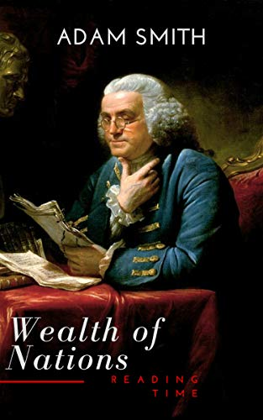
PRINCIPLE #6: Markets Are Usually A Good Way to Organize Economic Activity
A market economy allocates resources through the decentralized decisions of many households and firms as they interact in markets.
Famous insight by Adam Smith in The Wealth of Nations (1776):
Each of these households and firms acts as if “led by an invisible hand” to promote general economic well-being.
Adam Smith: The father of Economics
Notes:
23

Slide 24
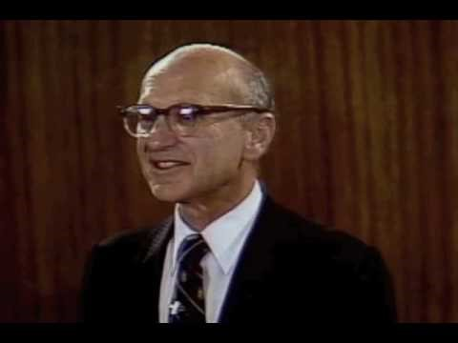
PRINCIPLE #6: Markets Are Usually A Good Way to Organize Economic Activity
The invisible hand works through the price system:
The interaction of buyers and sellers determines prices.
Each price reflects the good’s value to buyers and the cost of producing the good.
Prices guide self-interested households and firms to make decisions that, in many cases, maximize society’s economic well-being.
Notes:
24

Slide 25
PRINCIPLE #7: Governments Can Sometimes Improve Market Outcomes
Important role for govt: enforce property rights (with police, courts)
People are less inclined to work, produce, invest, or purchase if large risk of their property being stolen.
Notes:
25

Slide 26
PRINCIPLE #7: Governments Can Sometimes Improve Market Outcomes
Market failure: when the market fails to allocate society’s resources efficiently
Causes of market failure:
Externalities, when the production or consumption of a good affects bystanders (e.g. pollution)
Market power, a single buyer or seller has substantial influence on market price (e.g. monopoly)
Public policy may promote efficiency.
Notes:
26

Slide 27
PRINCIPLE #7: Governments Can Sometimes Improve Market Outcomes
Govt may alter market outcome to promote equity.
Because a market economy rewards people for their ability to produce things that other people are willing to pay for, there will be an unequal distribution of economic well-being.
If the market’s distribution of economic well-being is not desirable, tax or welfare policies can change how the economic “pie” is divided.
Notes:
27

Slide 28

The principles of HOW THE ECONOMY AS A WHOLE WORKS
0
Notes:
28

Slide 29
PRINCIPLE #8: A Country’s Standard of Living Depends on Its Ability to Produce Goods & Services
Huge variation in living standards across countries and over time:
Average income in rich countries is more than ten times average income in poor countries.
Real GDP per capita in India has risen by 219% since 1998 and has only fallen once in 2020.
Notes:
29

Slide 30
PRINCIPLE #8: A Country’s Standard of Living Depends on Its Ability to Produce Goods & Services
The most important determinant of living standards: productivity, the amount of goods and services produced per unit of labor.
Productivity depends on the equipment, skills, and technology available to workers.
Other factors (e.g., labor unions, competition from abroad) have far less impact on living standards.
Notes:
30

Slide 31
PRINCIPLE #9: Prices Rise When the Government Prints Too Much Money
Inflation: increases in the general level of prices.
In the long run, inflation is almost always caused by excessive growth in the quantity of money, which causes the value of money to fall.
The faster the govt creates money, the greater the inflation rate.
Notes:
31

Slide 32
PRINCIPLE #10: Society Faces a Short-run Tradeoff Between Inflation and Unemployment
In the short-run (1–2 years), many economic policies push inflation and unemployment in opposite directions.
Mainstream economists believe the following: An increase in the quantity of money causes spending to rise, which causes prices to rise, which induces firms to produce more goods and services, which requires that they hire more workers. Hence, in the short-run, increasing the quantity of money causes inflation to rise, but unemployment to fall.
Of course, REDUCING the quantity of money would have the opposite effects (inflation would fall, while unemployment would rise) in the short run.
Notes:
32

Slide 33
SUMMARY
The principles of decision making are:
People face tradeoffs.
The cost of any action is measured in terms of foregone opportunities.
Rational people make decisions by comparing marginal costs and marginal benefits.
People respond to incentives.

Slide 34
SUMMARY
The principles of interactions among people are:
Trade can be mutually beneficial.
Markets are usually a good way of coordinating trade.
Govt can potentially improve market outcomes if there is a market failure or if the market outcome is inequitable.

Slide 35
SUMMARY
The principles of the economy as a whole are:
Productivity is the ultimate source of living standards.
Money growth is the ultimate source of inflation.
Society faces a short-run tradeoff between inflation and unemployment.

Slide 36
Key Takeaways
The fundamental lessons about individual decision-making are that people face trade-offs among alternative goals, that the cost of any action is measured in terms of forgone opportunities, that rational people make decisions by comparing marginal costs and marginal benefits, and that people change their behavior in response to the incentives they face.
The fundamental lessons about interactions among people are that trade and interdependence can be mutually beneficial, that markets are usually a good way of coordinating economic activity among people, and that the government can potentially improve market outcomes by remeding a market failure or by promoting greater economic equality.
The fundamental lessons about the economy as a whole are that productivity is the ultimate source of living standards, that growth in the quantity of money is the ultimate source of inflation, and that society faces a short-run trade-off between inflation and unemployment.

